Slide 1


Glen Urquhart Childcare
Centre
August 2024
Newsletter

Slide 2
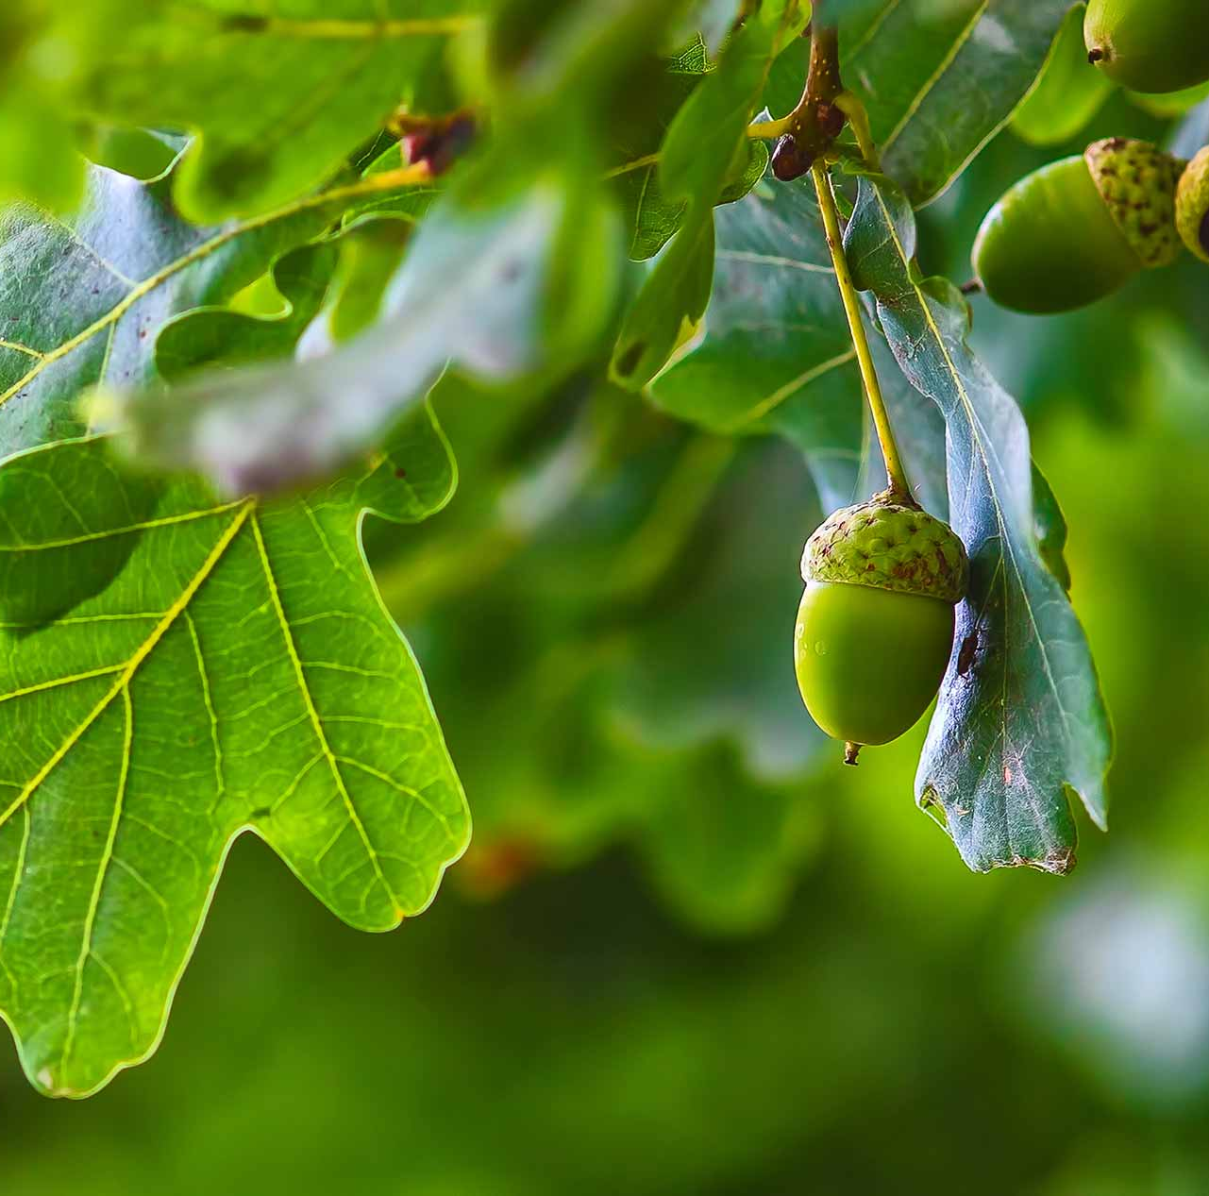
Oak Room News
A huge warm welcome to all our children who have begun their school year in the Oak room this term. The children have been settling in wonderfully, starting with drawing their own self-portraits. These will be on display in the foyer in the coming weeks for everyone to admire. The Oak room have spent the first week familiarising themselves with the local community and the children have spotted lots of different flags down on the pitch (set up for games day). This sparked a discussion about countries around the world so staff will work closely with the children this week to see how this evolves.
‘Look what I can do’ sheets have been sent home to families. This is an opportunity to strengthen the parental engagement bond between home and centre life. Here you can include any ‘wow’ moments from home, for example, first swimming lesson, trying new foods etc. Once they have been completed, they will be displayed in the foyer.
Forest School (every Thursday) will continue throughout the Nursery Year come rain or shine – there is no stopping us! All that we ask is that you ensure your child is appropriately dressed for the weather – it’s better to be over layered than under layered! Hats, gloves, scarves, warm jackets and footwear appropriate for wet, soggy terrain. You can leave items safely on your child’s peg.
Want to be in the loop? Sign up to our blog where you will receive weekly updates and pictures of what your child has been up too! Click on the link below, scroll to the bottom of the page: https://www.glenurquhartchildcarecentre.com/blog/

Slide 3
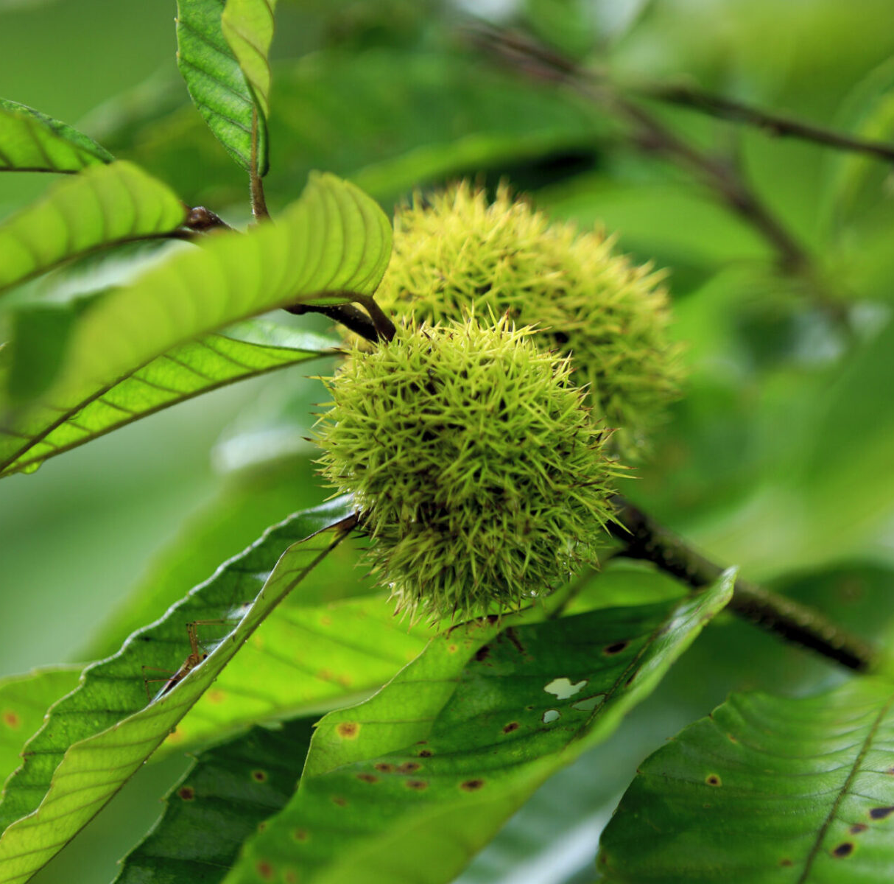
Chestnut Room News
Another huge warm welcome to all our children in the Chestnut room who are also settling in wonderfully to centre life. The staff and children have been working on a community wall display! They have been out and about in the village this week to provide them with an awareness of what is around them, taking pictures of buildings, local businesses, paths and roads to help them construct their very own community map. From doing this, the children have begun a discussion around different types of transport so staff will support them in the coming weeks to develop this interest.
‘Look what I can do’ sheets have been sent home to families. This is an opportunity to strengthen the parental engagement bond between home and centre life. Here you can include any ‘wow’ moments from home, for example, first swimming lesson, trying new foods etc. Once they have been completed, they will be displayed in the foyer.
Forest School (every Wednesday) will continue throughout the Nursery Year come rain or shine – there is no stopping us! All that we ask is that you ensure your child is appropriately dressed for the weather – it’s better to be over layered than under layered! Hats, gloves, scarves, warm jackets and footwear appropriate for wet, soggy terrain. You can leave items safely on your child’s peg.
Want to be in the loop? Sign up to our blog where you will receive weekly updates and pictures of what your child has been up too! Click on the link below, scroll to the bottom of the page: https://www.glenurquhartchildcarecentre.com/blog/

Slide 4

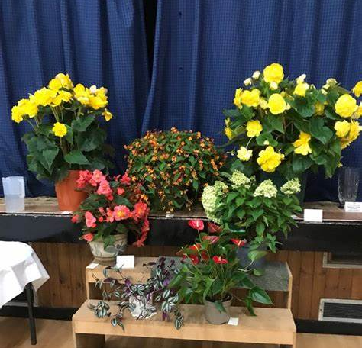
Glen Urquhart Flower show
The Glen Urquhart Horticultural Society’s annual flower show is fast approaching. This is always a beautiful demonstration of the community coming together to engage and support each other. Our wonderful nursery children have been working hard behind the scenes and will be entering into the preschool & p1 category, specifically ‘flowers in an unusual container’.
Schedule for the Day: Exhibits must be delivered to Glen Urquhart Public Hall on Saturday, August 30th, between 9:30 AM and 12:00 noon. Each exhibit incurs an entry fee of 50p, and an entry form will need to be filled out at the entrance. The show will commence at 3 PM (entrance fee £2 for children and £5 for adults), allowing attendees to view all the exhibits and the winners from each category.
If you are unable to drop off your entry, please reach out, as staff may be available to assist in ensuring your child does not miss this opportunity. If you can retrieve your child's entry, please ensure that you pick up their exhibit by Friday at the latest.

Slide 5

Current
Fundraising:
We currently have two fundraisers on the go:
Our Summer Raffle – the prizes for this are out of this world! Thank you to all who have donated. We will be drawing this 02/09/24 so be quick if you want a last-minute chance. Prizes include return tickets to London (for 2) on the Caledonian sleeper, tickets to Edinburgh Zoo, Scotrail tickets, Hou Hou Mei voucher, Rocpool voucher exhibition centre entry and LOADS MORE. Please call the centre or pop in for a ticket.
We have popped out sponsor forms to the nursery children who may wish to take part in the ‘Wee Nessie’ Baxter's event on the 29th September. This event is open to pre-school children aged 5 and under and follows a short (approx. 800m) circular route in the enclosed Bught Park. It allows children to walk, jog or run at their own pace, providing a perfect introduction to the sport. We would love if parents, along with their children, could gather as many sponsors as possible.
Click here to sign up https://lochnessmarathon.com/event/wee-nessie-4/?_gl=1*1mgr6ki*_ga*OTg0MzQ5MTE0LjE3MjQ5MzA1MjI.*_ga_SWB2C98X13*MTcyNDkzMDUyMS4xLjEuMTcyNDkzMDUyMS42MC4wLjA.&_ga=2.128316043.663668718.1724930522-984349114.1724930522

Slide 6

We need YOU!
Due to our charitable status, we fundraise for ALL our resources and equipment!
We would like to set up a fundraising committee to kick start our efforts.
Are you organised? Want to meet new people? Have a creative side dying to break out? Or can work wonders with your helping hands?
Pop into the office for a chat where we will guide and assist.

Slide 7

Charitable
Status Update
Did you know that our breakfast, out-of-school, and holiday clubs are entirely funded through our own efforts? We depend significantly on donations, grants, and the revenue generated from fees annually to ensure these programs remain sustainable.
Unfortunately, we only had four children participating during the week from 5:30pm to 6:00pm (Monday to Thursday), and frequently, there were no children after 4pm on Fridays. After operating this provision at a considerable loss for over a year, the decision was made to adjust the closing hours to 5:30pm Monday to Thursday and 4pm on Fridays.
Moving forward, these changes aim to guarantee the stability and sustainability of all aspects of our service, as the decrease in operating hours has also led to a substantial reduction in staffing expenses

Slide 8

Investment in our Staff
We pride ourselves on the retainment of high-quality staff members. Behind the scenes, the staff at the centre work tirelessly to better their skill set, improve their practice and learn new skills – a journey of self investment.
What have we been up too?
Chloe and Marika completed their 3day first aid training
Emma, Sian, Marika and Chloe all completed their level 2 child protection course
Emma, Sian, Audrey, Marika and Chloe attended GIRFEC refresh and reset training
Marika and Kerry completed coordination difficulties workshop as well as a change, loss and bereavement course
Aimee attended words up ‘key messages’ training.
All staff attended ASN training workshop.

Slide 9

Meet the Trustees
Our Scottish Charitable organisation is managed by a group of volunteer trustees. At present, we have 4 trustees who ensure the overall management and policy making at the centre. Each trustee member brings with them a specialised skill set that enables innovative and dynamic leadership.
Their varied careers bring balance and expertise to the decision making. These include backgrounds in teaching, social work, self employed business owners, administration and health & wellbeing practices. This combined with the experience, knowledge and expertise of the Manager and staff employed at the centre, ensures that the whole Glen Urquhart Childcare team can provide high quality care and education whilst enabling the Trustees to act as the ‘guardians of purpose’
Check out our ‘meet the trustees’ section on our website:
https://www.glenurquhartchildcarecentre.com/trustees/
We will be running an open evening in the next few weeks (please keep an eye out for a date)This will be an informal evening to chat, hear about the centre and get to know the people behind the scenes and opportunities to join our board.

Slide 10
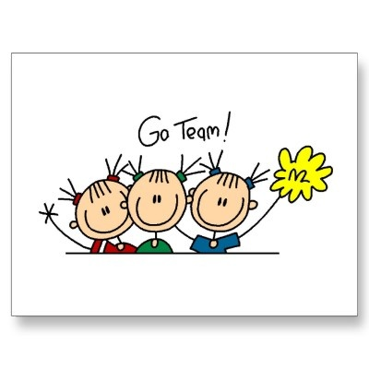
Small wins for big things
We work quietly behind the scenes to fundraise, and grant find so we can directly source toys and equipment for the centre. Recently we have rasied:
Soirbheas photo competition £100
Templa Spa evening and raffle £245.80
Rag Bag £113.90

Slide 11

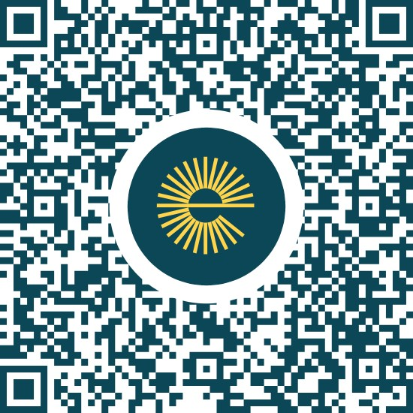

Help us earn!
Use easy fundraising every time you shop online! Click the link below to see the retailers that are part of the campaign. Over 4,000 shops and sites will donate, so you can raise FREE donations for us no matter what you are buying. These donations really help us out, so please sign up for free!
For every 5th time you shop you’ll receive £3 to either spend on a coffee for yourself OR you could donate it to us at the centre! Last year £179.56 was donated to the centre from shoppers.
For extra bonus points, add the easy fundraising browser extention to your phone or desktop so you can donate to us without even thinking!!
https://www.easyfundraising.org.uk/donation-reminder/?efr_source=website&efr_medium=easyfundraising&efr_campaign=header-navigation

Slide 12


Rag Bag
Do you have any old shoes and clothes that no longer fit you or your child? We have a rag bag station at the front of the nursery that will happily recycle any unwanted items of clothing. This scheme is a fantastic way of ensuring clothes don’t go into landfill but instead can be recycled for other uses. The Glen Urquhart Childcare Centre also receives money per kg of donated clothes which goes directly back to the children.
We Accept: Will not Accept:
Wearable clothing Work wear/Uniforms
Paired Shoes Wet/soiled clothes.
Handbags Curtains/carpets/towels
Belts Duvets/Pillowcases
Blankets/Cushions/Linen
Suitcases/Books/Bric-a-Brac

Slide 13



It’s good to be social!
Modern platforms allow us to reach you at time that suits you best. We update our pages on a regular basis to with information such as:
- Upcoming events and important dates
- Improvements to our provision
- Fundraising efforts
- Volunteer requests
- To simply spread some joy with happy little pictures & reels
https://www.facebook.com/glenchildcare/
https://www.instagram.com/glenchildcare/

Slide 14

Important Dates
Saturday 30th August: Horticultural Show in Glen Urquhart Public Hall
Monday 16th & Tuesday 17th August: Holiday Club
Tuesday 10th September: A dental practitioner from NHS Child Smile will visit to discuss tooth brushing. Children will all receive a toothbrushing pack to take home
Monday 14th – Friday 18th October: Holiday Club
Monday 21st October – Friday 25th October: Centre closed
Monday 28th October: Centre reopens
Monday 28th, Tuesday 29th & Wednesday 30th October: Safe, Strong & Free workshops for preschool children (more information to follow)
Thursday 31st October: Halloween parties for nursery & goosc (more information to follow)

Slide 15


Contact us
As always, we’d love to hear from you! If you have any feedback for us on our provision, ideas to help with fundraising/improvement or to simply seek some advice, get in touch:
Is there something you would like to see in our newsletter? Get in touch and share your ideas.
01456450679
Audrey: manager@glenurquhartchildcarecentre.co.uk
Chloe: assistantmanager@glenurquhartchildcarecentre.co.uk
(Currently on Mat leave)
Sian: supervisor@glenurquhartchildcarecentre.co.uk
bookings@glenurquhartchildcarecentre.co.uk
Donna: adminstrator@glenurquhartchildcarecentre.co.uk

